Slide 1
2d Lt Aaron Bonner
Validating Assumptions in a Laser Speckle Simulation

Slide 2
Overview
Previous Work on the Simulation
Spatial Coherence
Non-Linear Calibration
Polarization
Phase Retrieval

Slide 3
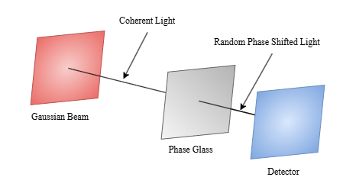
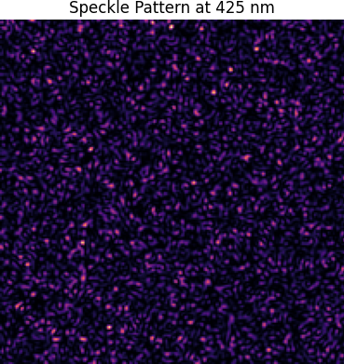
Previous Work
Simulated system based on
Gaussian Beam
Phase Screen w/Aperture
Detector Plane
Assumptions
Phase screen is uniformly random
Speckles are accurately generated
Sensor is correctly calibrated
Speckles appear at low power

Slide 4
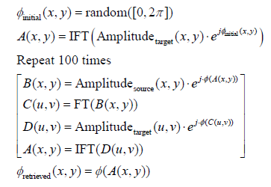
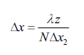
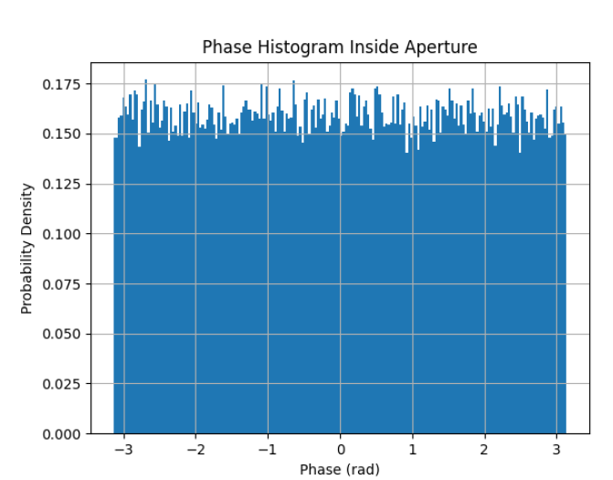
Phase Retrieval
Phase screen is uniformly random
Lab setup w/ 75mm lens
Aperture Mask
Initial Guess
G-S Algorithm
Notes:
Want data of same phase and intensity
Mask is 6mm converted to pixel space

Slide 5
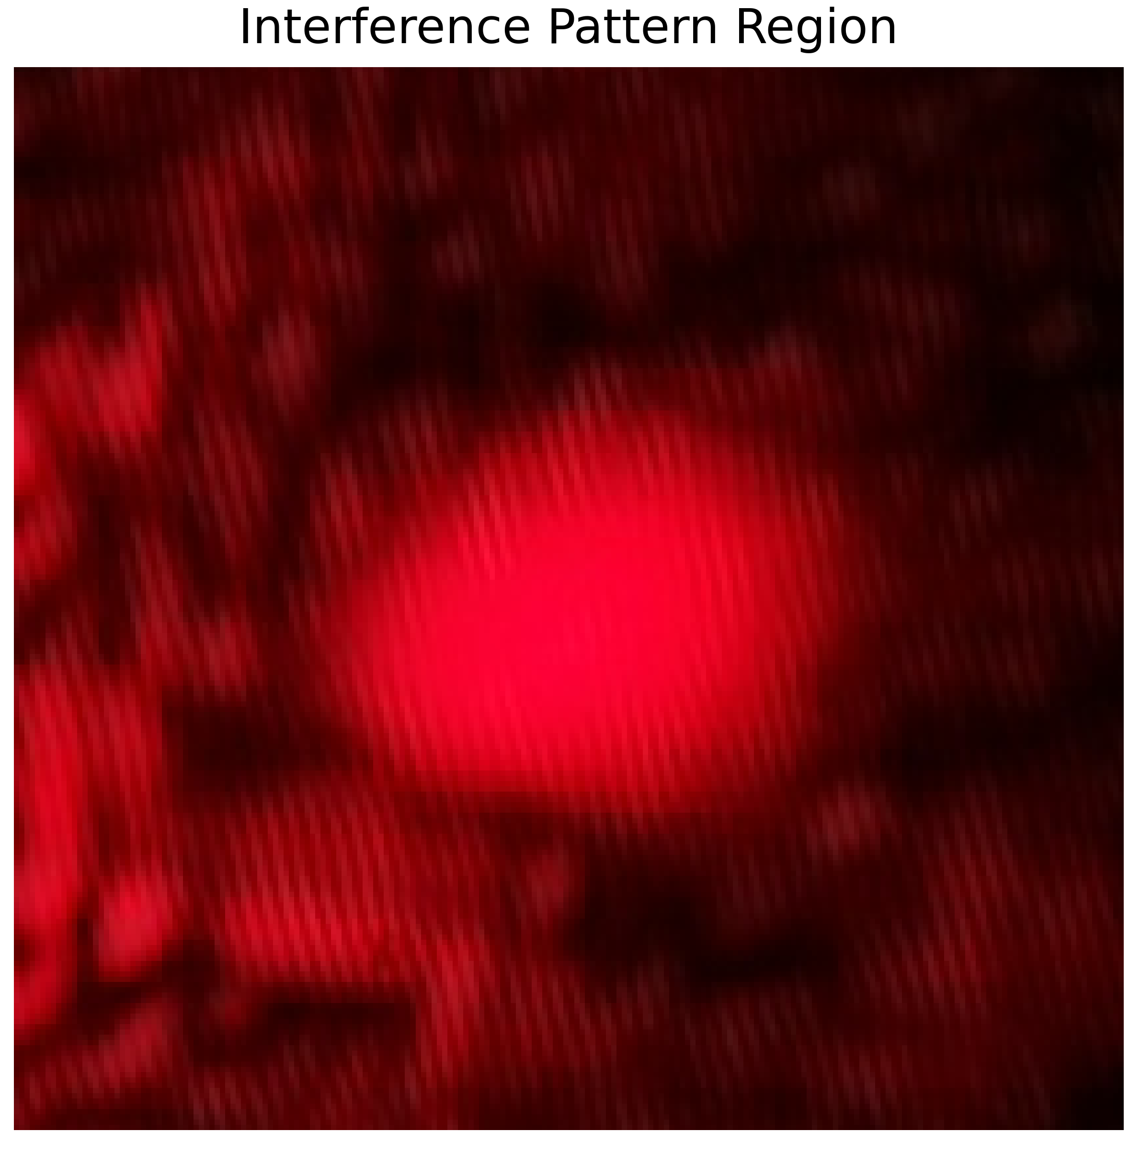
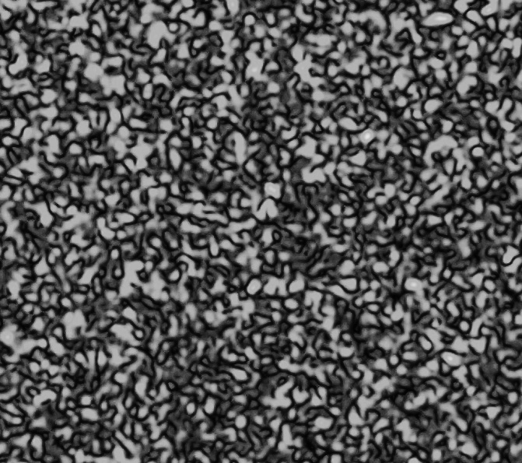
Spatial Coherence
Speckles are accurately generated
Speckle pattern form from coherent light
Higher coherence increases sharpness
Wavelength impacts speckle size

Slide 6
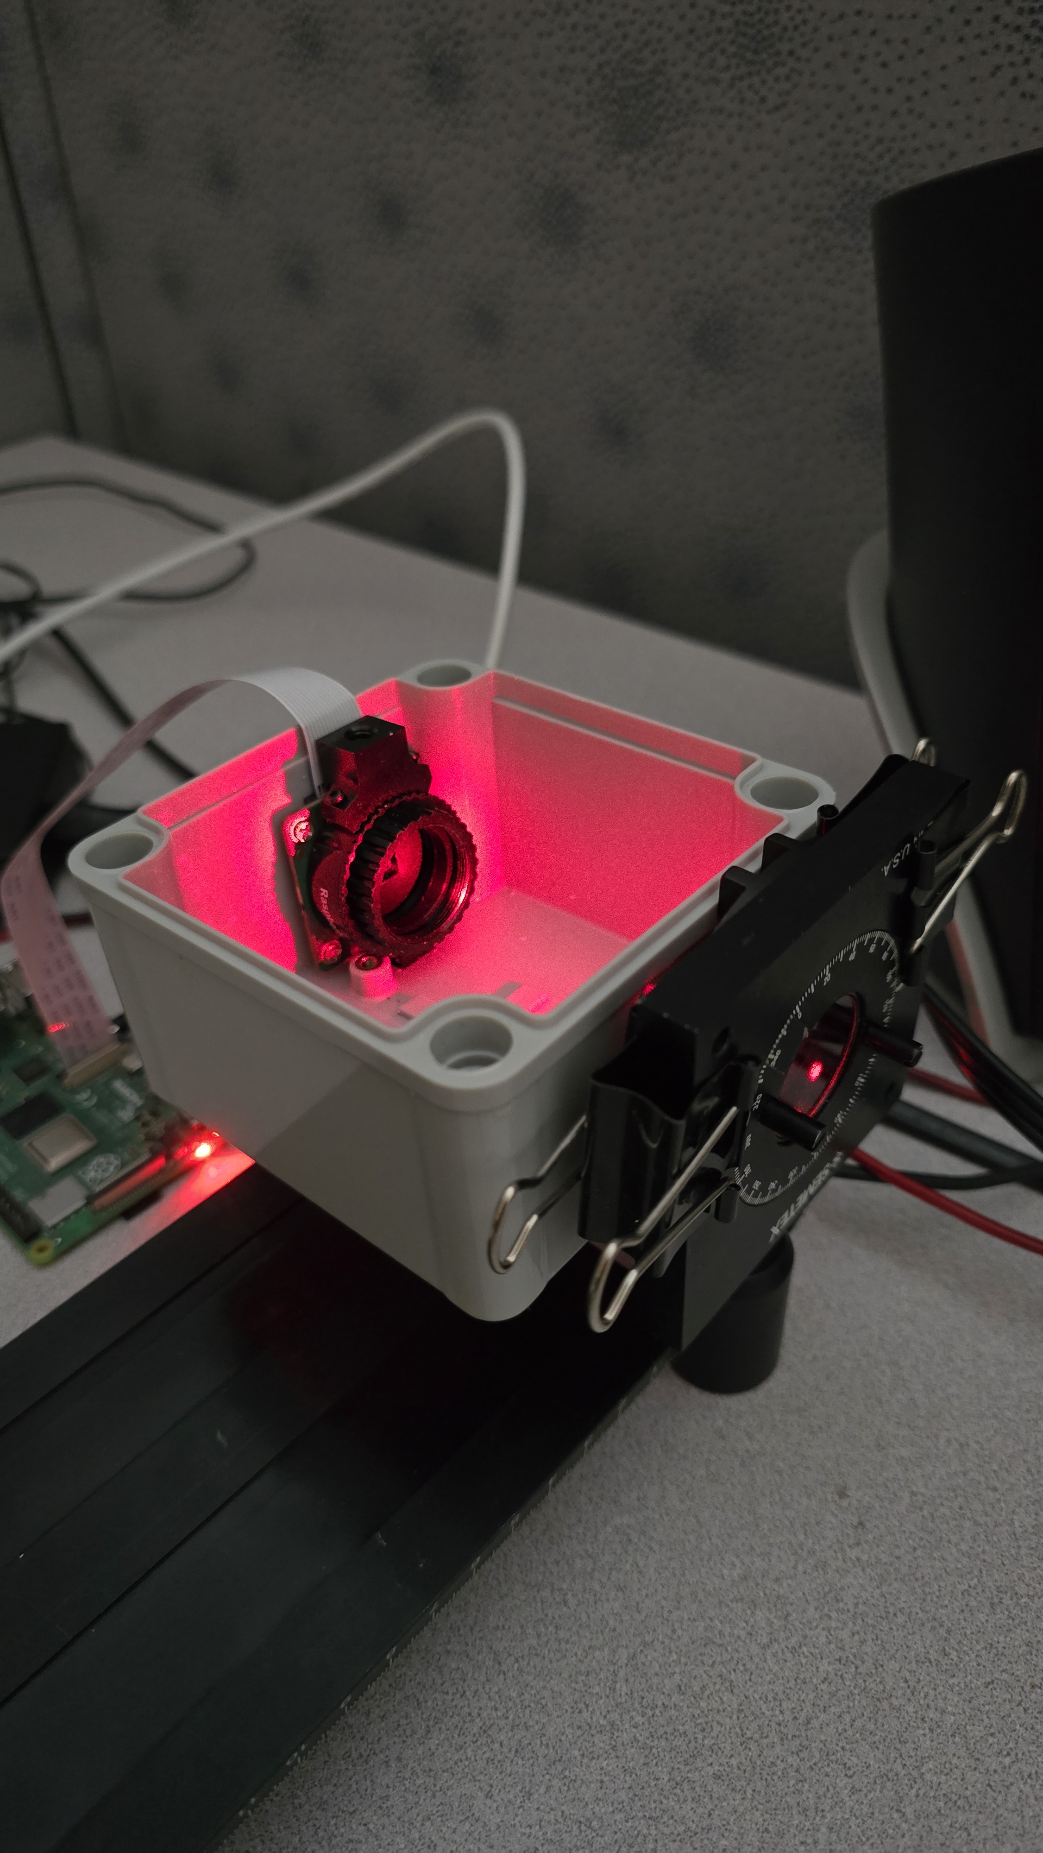
Non-Linear Calibration
Sensor is correctly calibrated
Estimate laser power by hand
Calculate SANUC & NLSNUC
Future usage

Slide 7
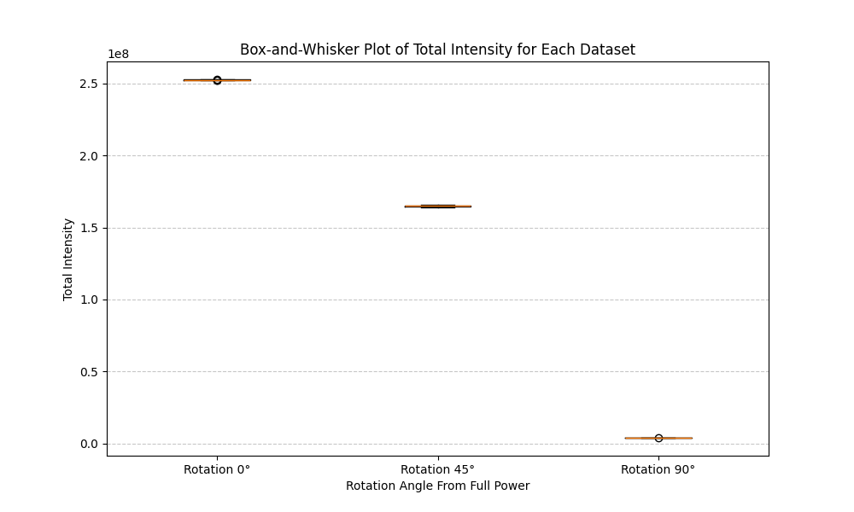
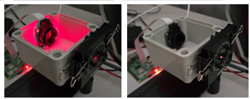
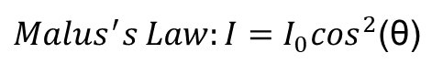
Polarization
Speckles appear at low power
Use polarizer to emulate low power
Calibrate
Convert from photons to power
$Malus^{′}s Law:I=I_{0}\cos^{2}$(θ)

Slide 8
Summary
Previous Work on the Simulation
Spatial Coherence
Non-Linear Calibration
Polarization
Phase Retrieval

Slide 9

Questions

